Slide 1

Gargiulo summer swim program
@
Swimtastic Swim School
Summer 2018
10 swim lessons

Slide 2

1st Day at the pool
Swimtastic Swim School accepted 32 Gargiulo students for the summer swim program.
The program included 10 group lessons (2 times per week).
At the start of the program none of the students could swim alone. they didn’t want to put their eyes in the water, had no breath control, and no water adaptation skills.
A common comment on the first day was, “we cant swim and we are going to drown.”
Students knew that water meant danger, fear, and that deep water equaled drowning and death.
Many students had not been in a pool bigger than a plastic kiddie pool, and THEY had never been in formal swim lessons.

Slide 3


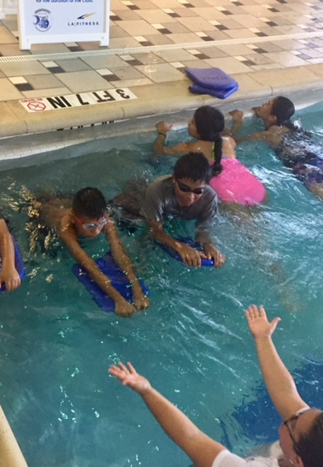
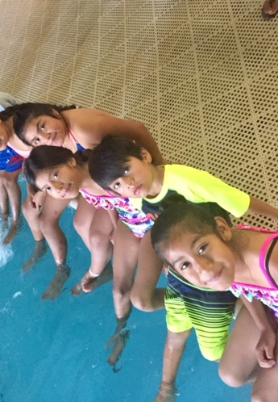
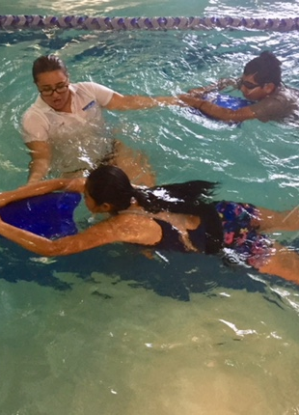
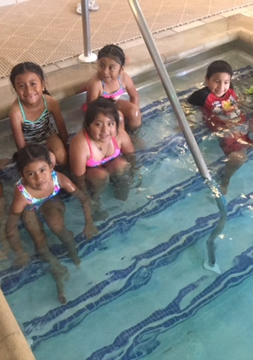
1st Day at the pool
Swim tested every student.
Students put their fear aside and all of them got in the water.
Getting the students comfortable in the water on the first day was a huge success.

Slide 4
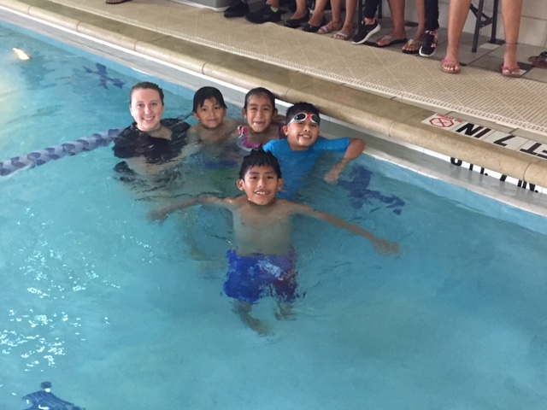
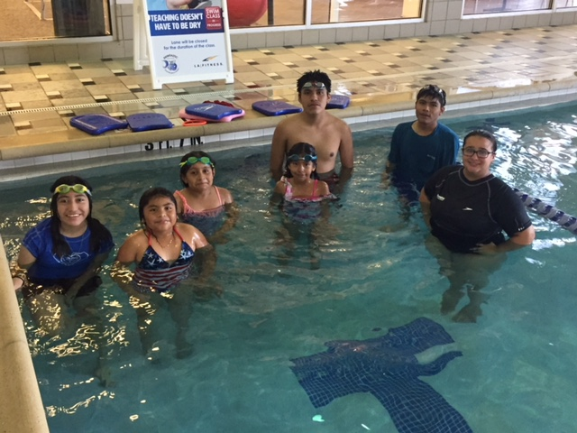
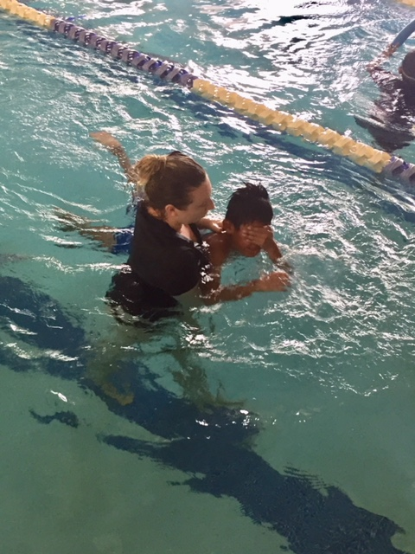
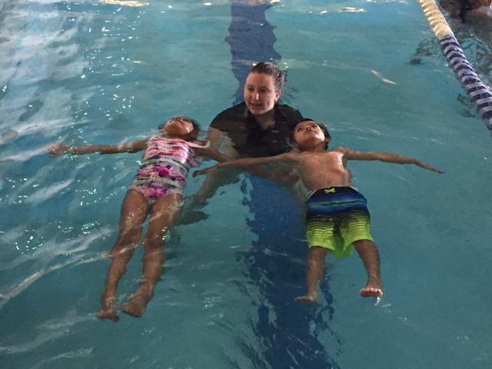

Slide 5
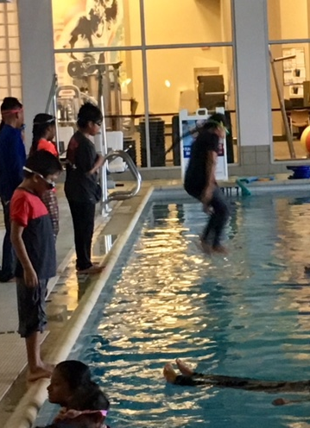
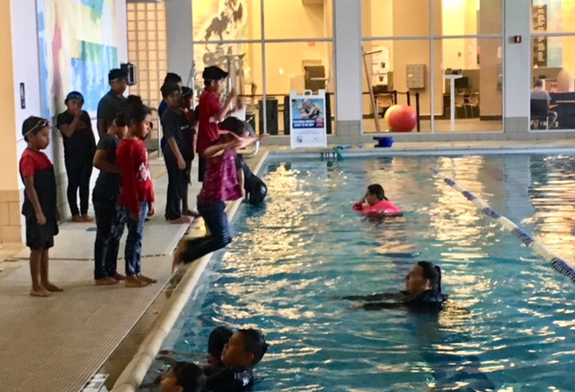
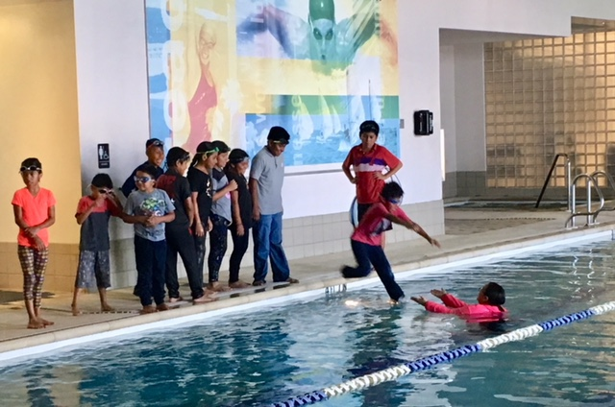
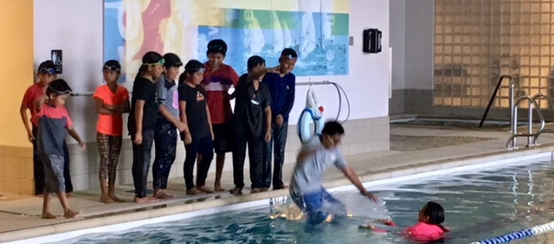
Water Safety Day
As the students became swimmers the Swimtastic squad realized the students did not know about water safety.
Water safety day included: jumping in/swimming with clothes on, learning how to watch the water, & what to do if someone needs help in the water.

Slide 6
Last day of lessons
(10th Swim lesson)
The Gargiulo student swimmers are completed the summer swim program.
Graduation for each student with swim central safety certificates & Swimtastic swim levels certificates.
Swimmers went from fearful & hesitant on day 1, to fully swimming, floating, and adapting in the water.
Our older swimmers started working on strokes & form: freestyle, backstroke, and flip turns (we would love for some to go on to swim team).
The younger swimmers can float, put their eyes & bubbles in, and know basic kicks to fall in and get back to the wall.
Swimming is a life long skill that every person needs. Swim lessons save lives, and just like any other skill should be practiced and refreshed.

Slide 7
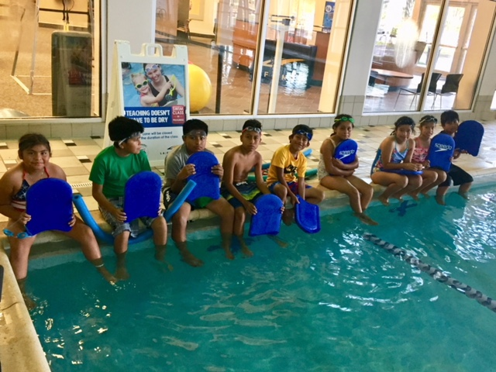
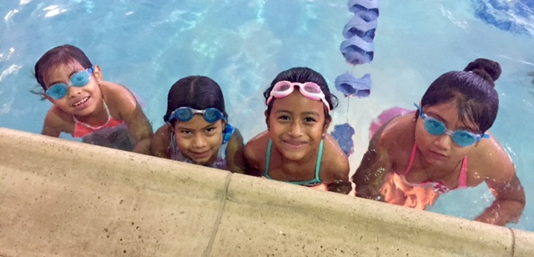
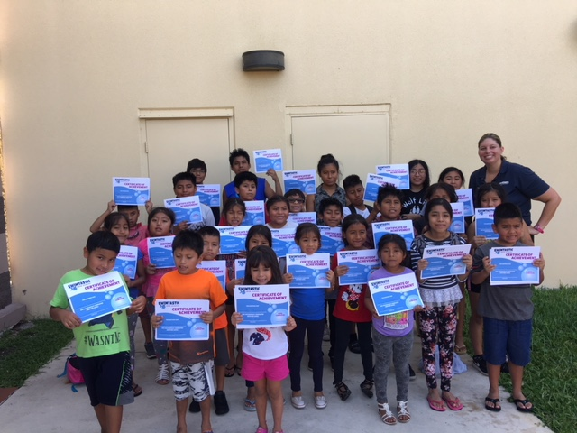
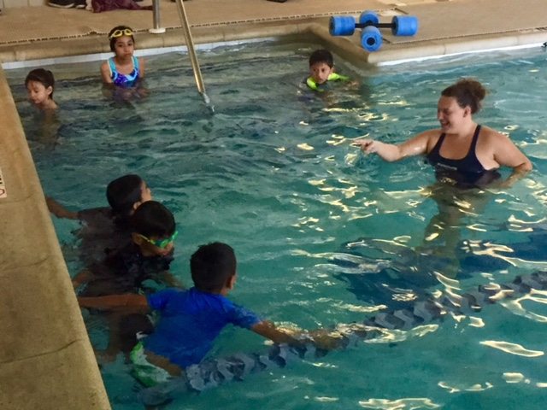
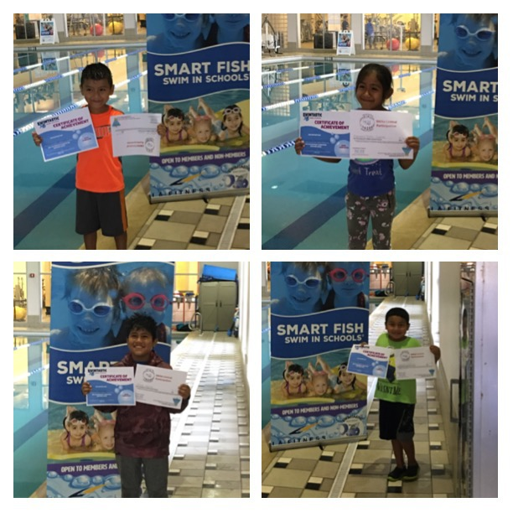
Last Day & Graduation

Slide 8
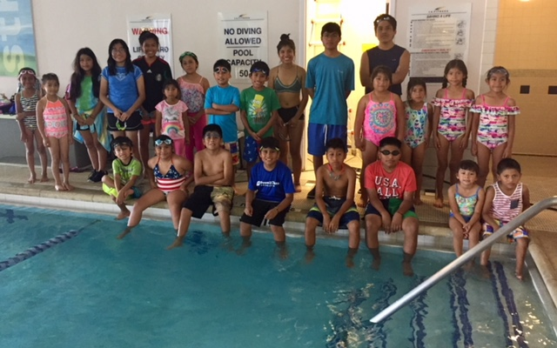
Thank you to all our partners
Gargiulo Education center
Bridge fund
Safe & healthy children’s coalition of collier county
Swim central
Swimtastic swim schools of sw Florida
Private donors

